Slide 1
Caring for Creation
Fifth Mark of Mission
“To strive to safeguard the integrity of creation, and sustain and renew the life of the earth”
Sunday 2nd May 2021

Slide 2
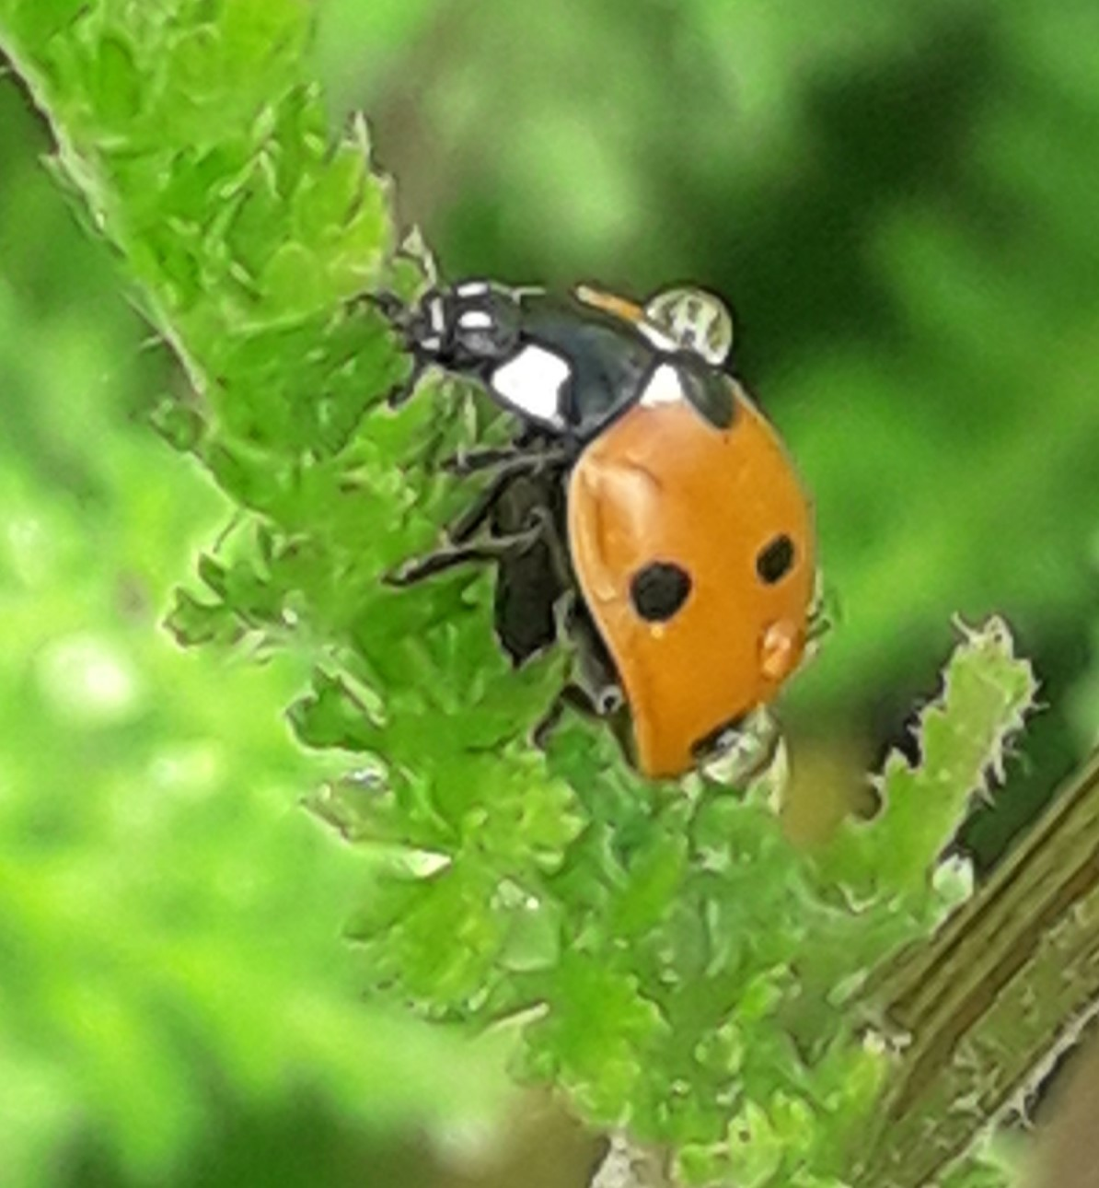
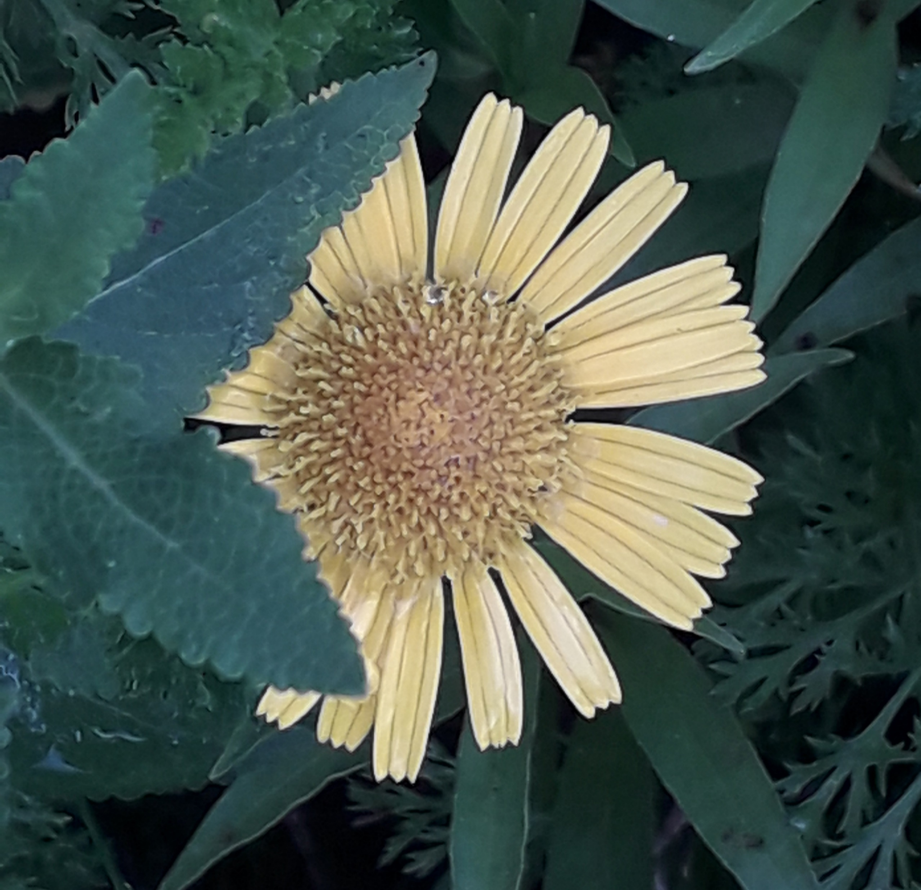
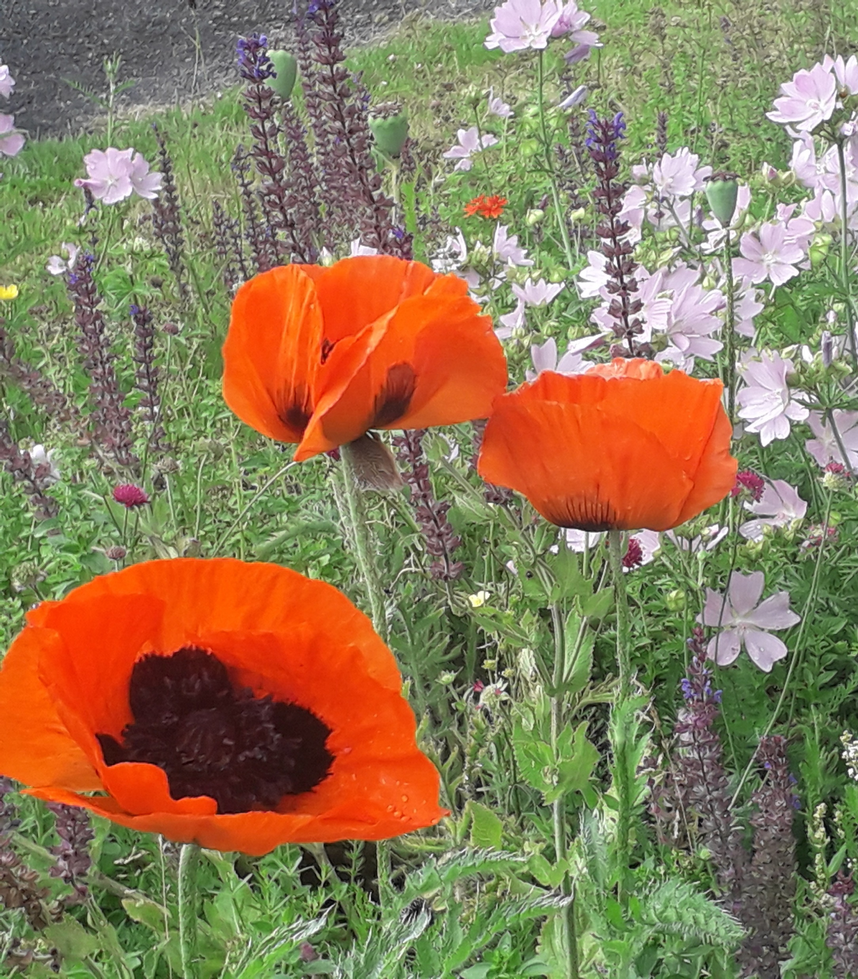
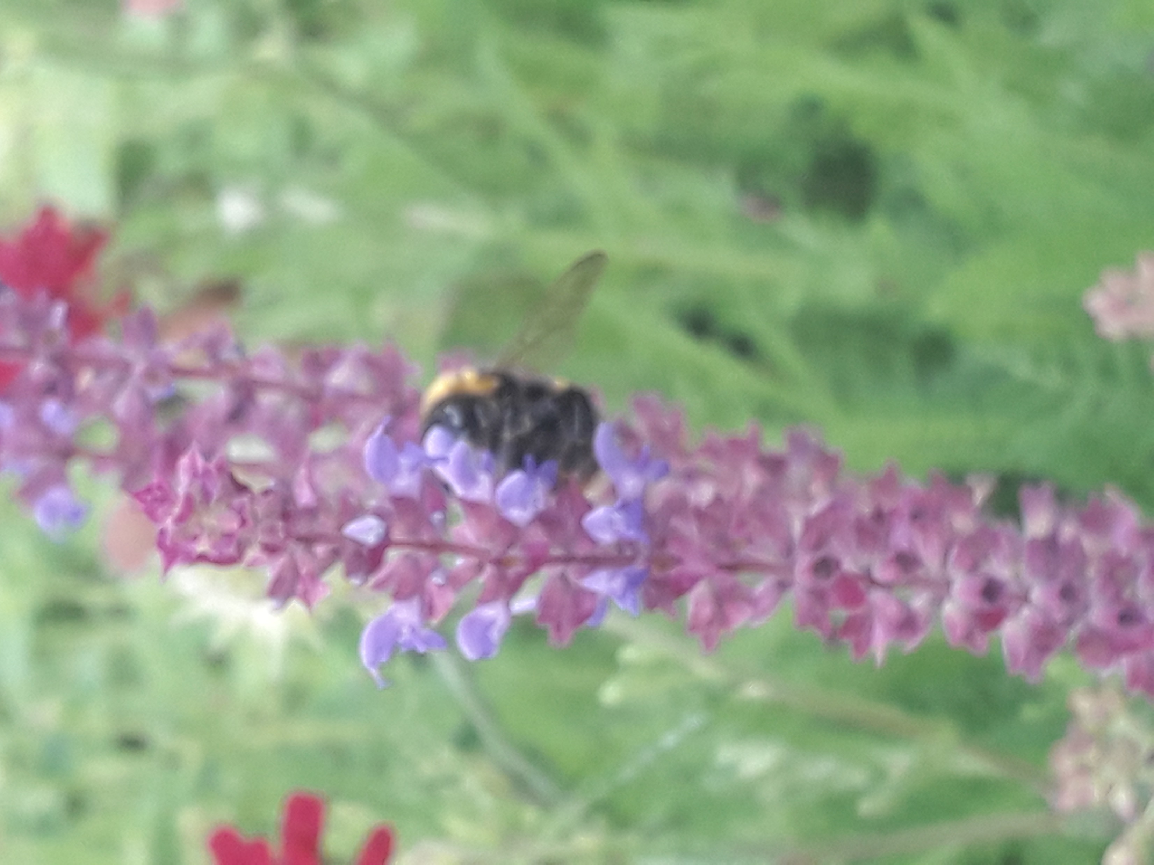
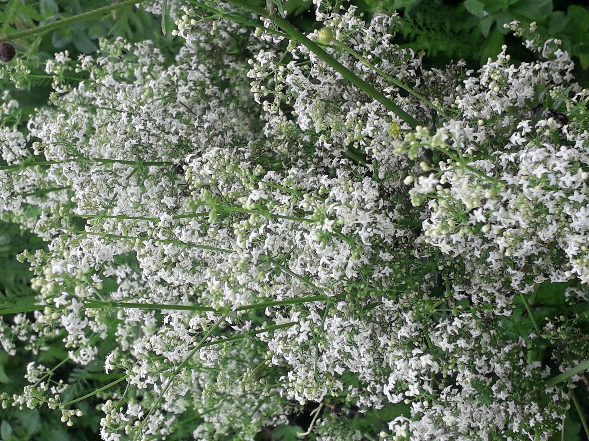
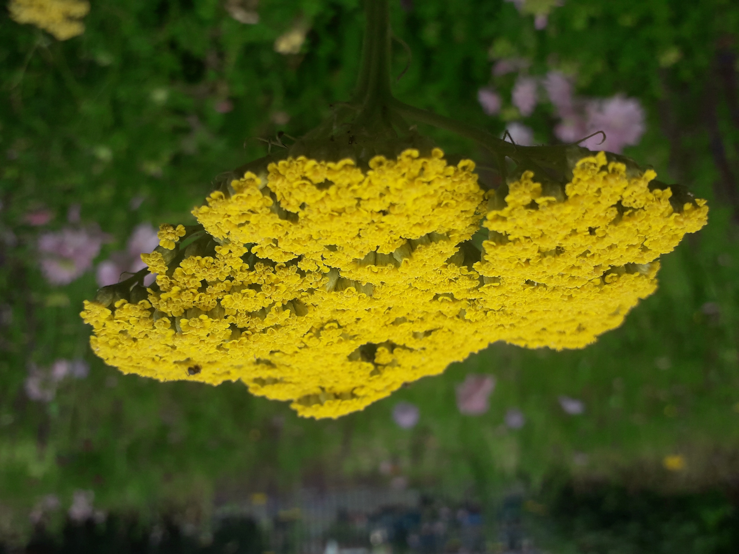
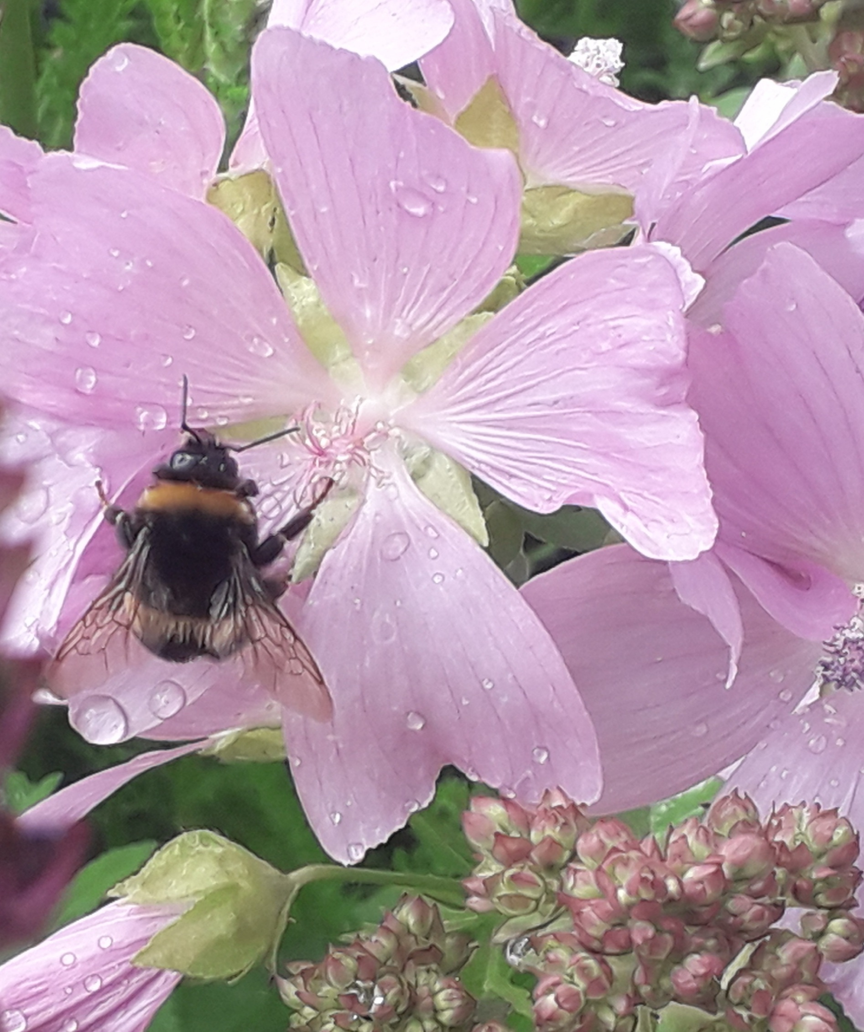

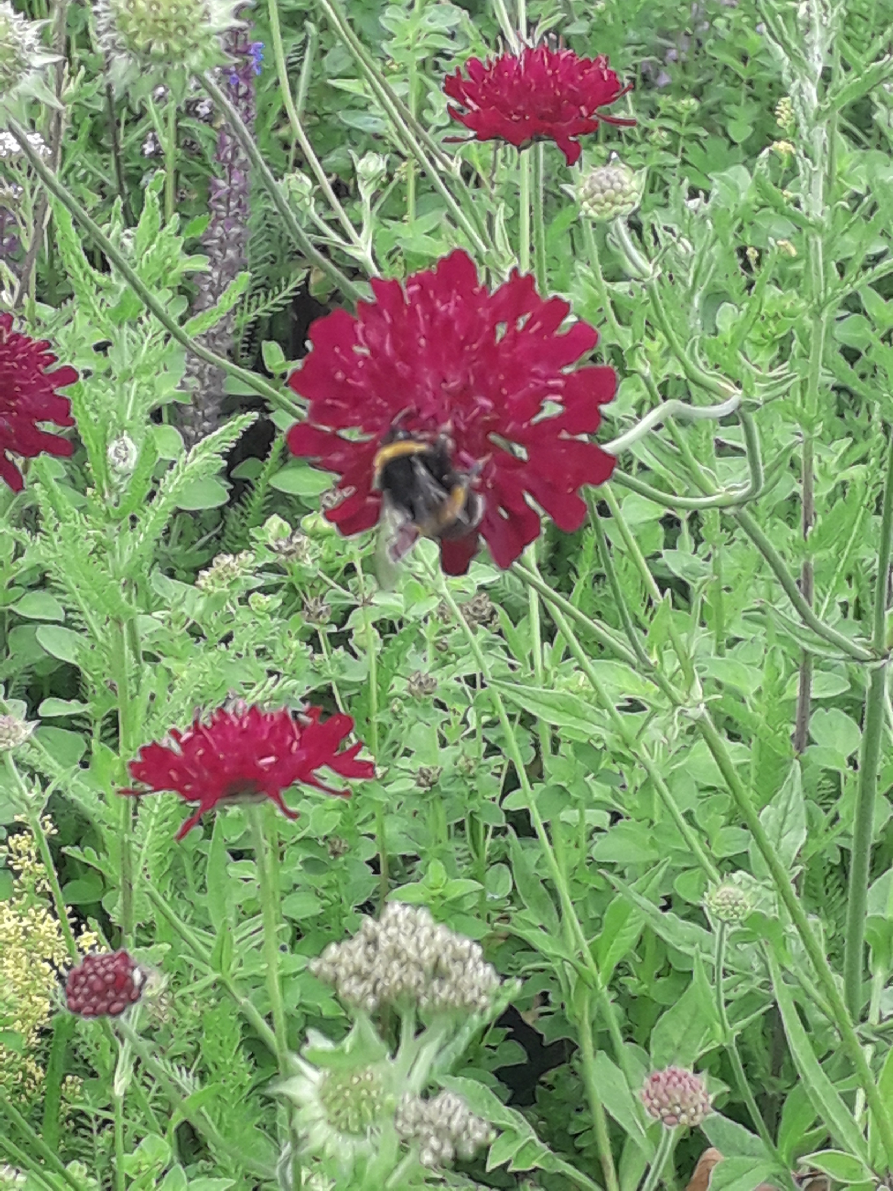
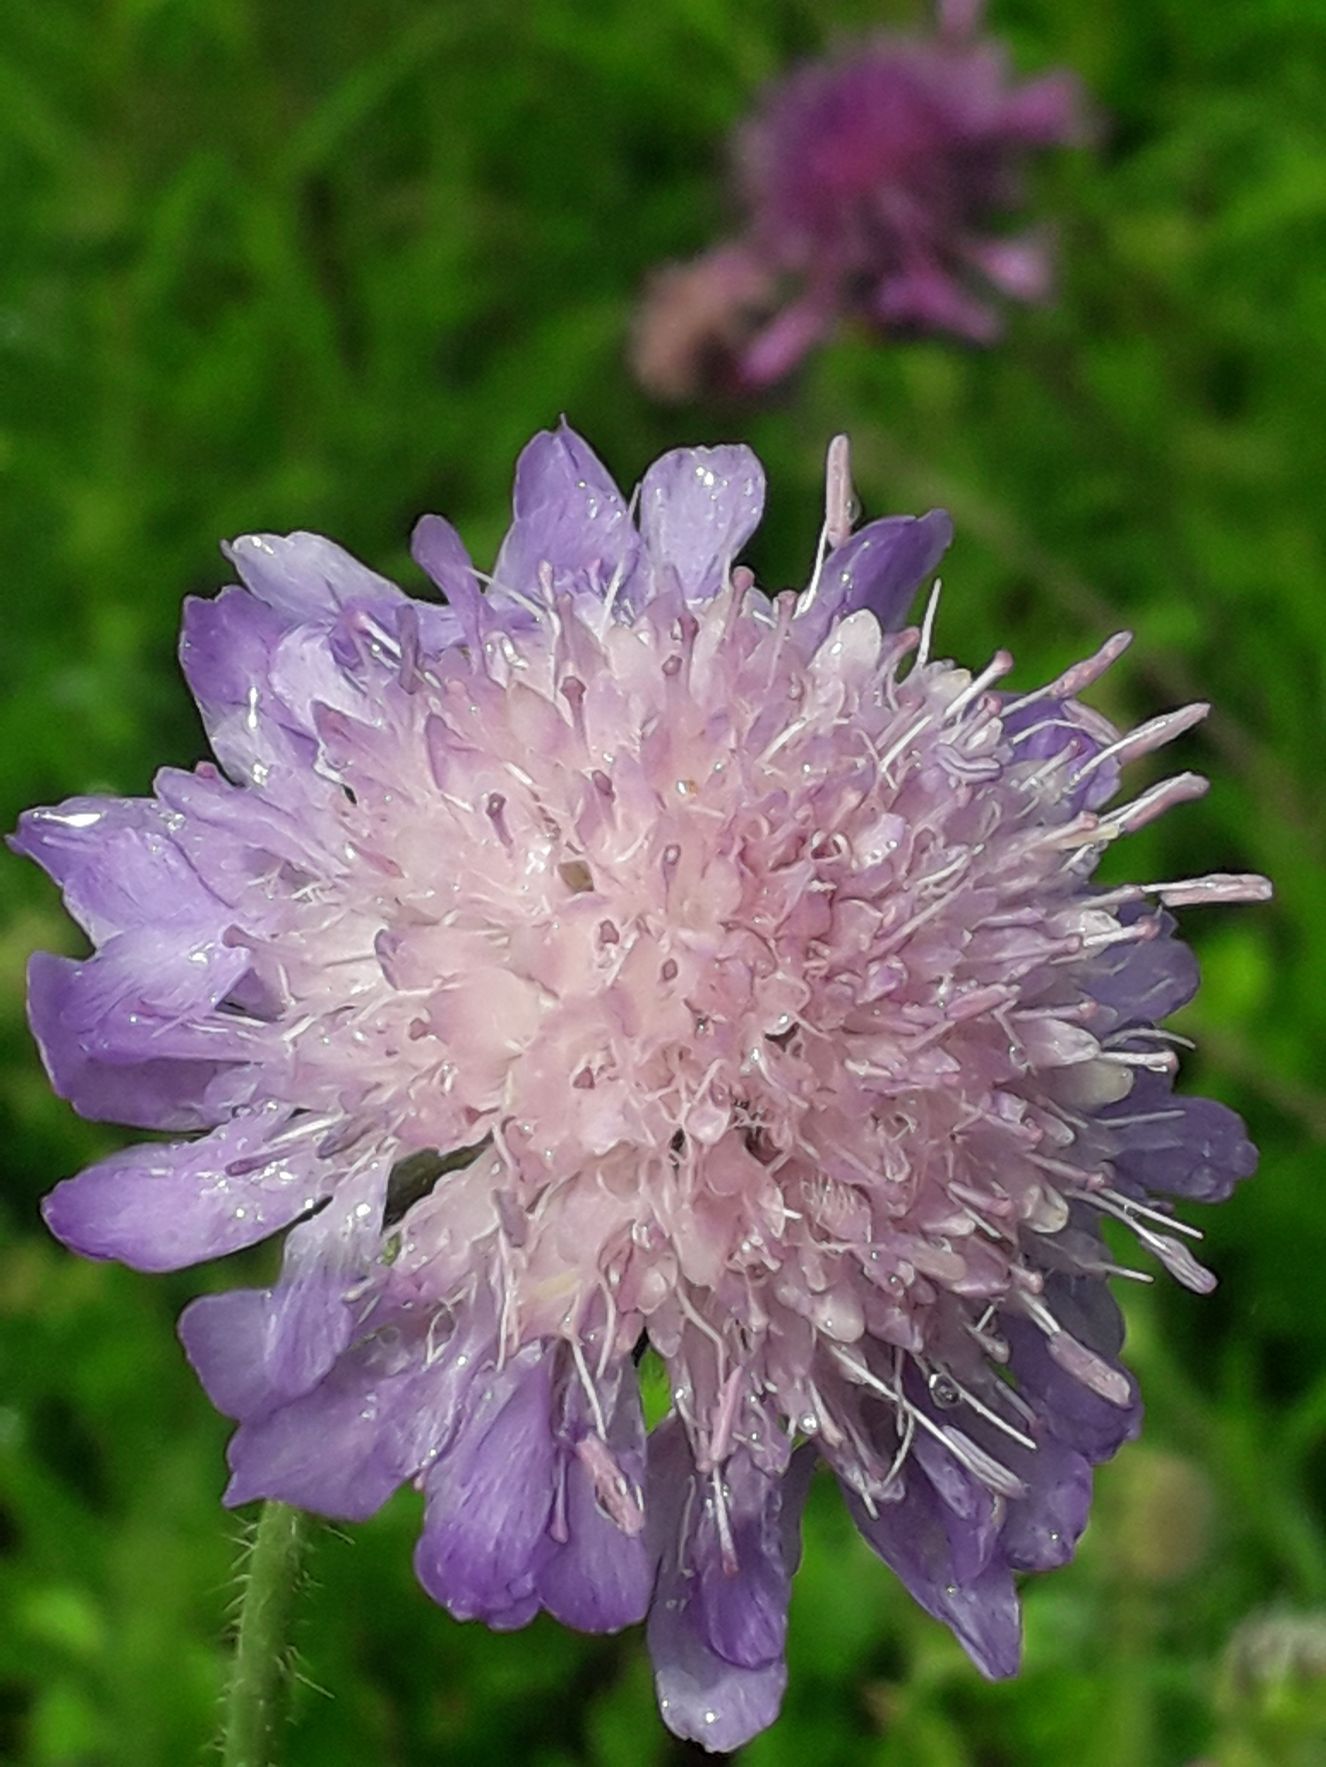
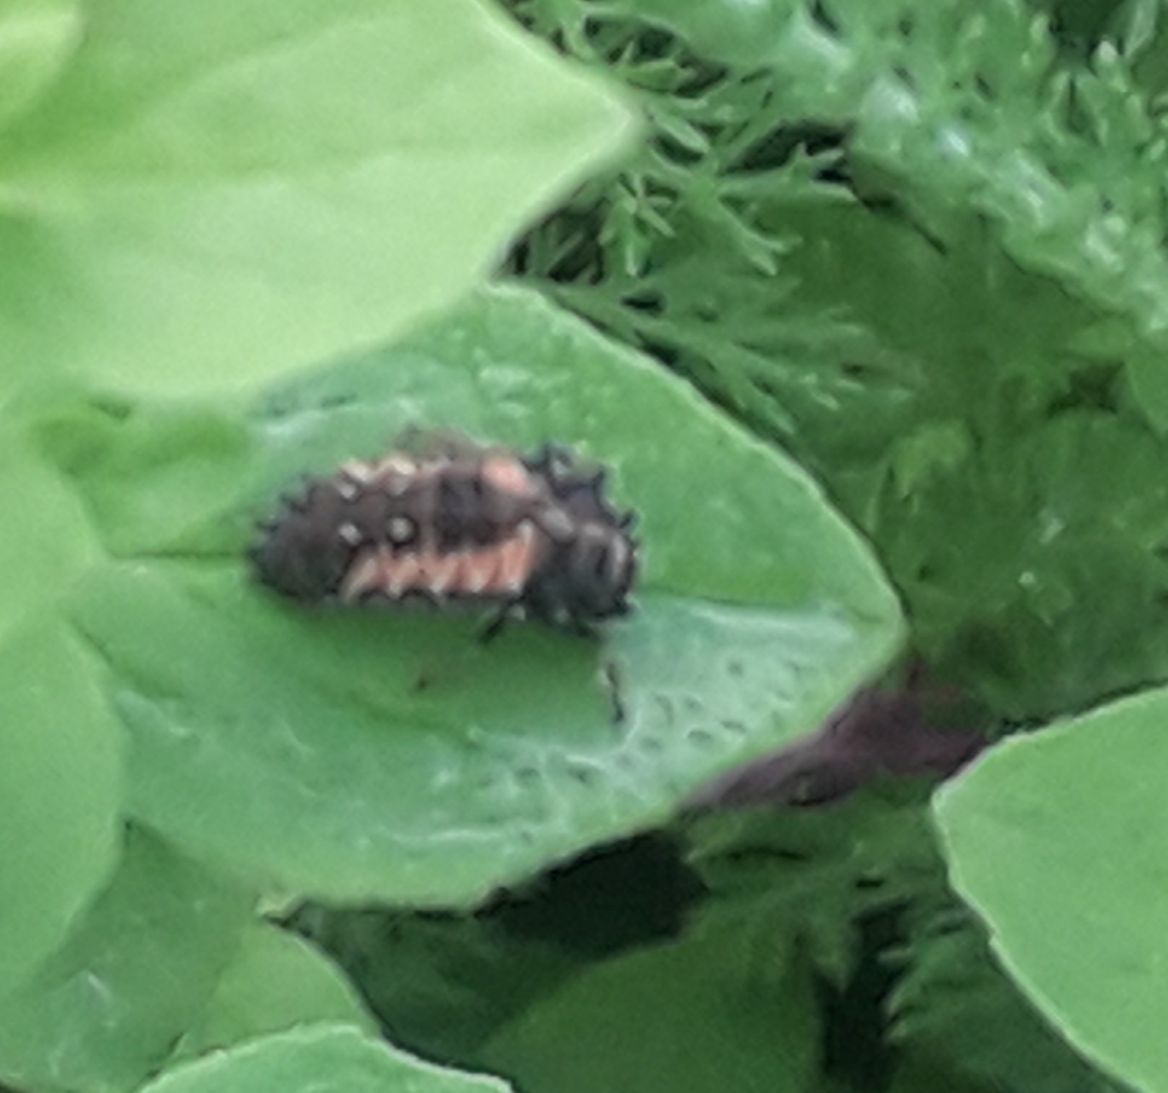

Slide 3
God Created – And God saw that it was Good
It is a witness to Him
Romans 1 19-20 ¹⁹since what may be known about God is plain to them, because God has made it plain to them. ²⁰For since the creation of the world God's invisible qualities-his eternal power and divine nature-have been clearly seen, being understood from what has been made, so that people are without excuse.
Because it was good. (Gen 1 – Each day – And God saw that it was good)
For Jesus – a love gift for His Son.
Col 1: 16b …all things have been created through him and for him.

Slide 4
God Created – And God said
And God said (Gen 1)
His word went out and achieved its purpose
Isaiah 55:10-11 As the rain and the snow come down from heaven, and do not return to it without watering the earth and making it bud and flourish, so that it yields seed for the sower and bread for the eater, ¹¹so is my word that goes out from my mouth: It will not return to me empty, but will accomplish what I desire and achieve the purpose for which I sent it.
Jesus is the word
John 1: 1-4 In the beginning was the Word, and the Word was with God, and the Word was God. ² He was with God in the beginning. ³ Through him all things were made; without him nothing was made that has been made. ⁴ In him was life, and that life was the light of all mankind.
He is a God of relationships- creation reflects His relational character.
Everything in creation relates – it is interdependent.
God relates to His creation – it is not just about God & humans
Incarnation – Jesus became part of creation – healing those parts of creation that needed fixing – Lord over the forces of nature.

Slide 5
God Created Man – in his own image
Rediscover our humility.
Made from the dust – same as everything else (Gen 2:7, Gen 2:19)
Didn’t get our own day, made alongside the other animals (Gen 1: 24-31)
We are part of creation and are dependent on it.
Job 38-39 – where were you when I made all this?
But made in God’s image (Gen 1:27)
Naming – knowledge & understanding – partnering with God in stewardship (Gen 2:19-20)
Dominion – Lordship – to serve rather than dominate or exploit (Gen 1:28, Gen2:15)
The Lordship of Christ – the servant king.
World would be better off without us? It shouldn’t be!
Need to discover 5th Mark of Mission, rediscover God’s first calling
And it is to us all

Slide 6
The Fall – Cursed is the ground because of you
When sin came into the world because of us – the perfection of creation was destroyed.
All the good relationships God created were spoilt – God/humans, God/creation, humans/humans, humans/creation
Gen 3:17 Cursed is the ground because of you
Rom 8:20 ²⁰ For the creation was subjected to frustration, not by its own choice, but by the will of the one who subjected it
Our treatment of the world, “… through negligence, through weakness and through our own deliberate fault.”
Our stewardship of the planet will be judged.
Rev 11:18 “The time has come for judging the dead … and destroying those who destroy the earth”
It is an issue of justice
Environment needs a spiritual response

Slide 7
Jesus – Source, sustainer & saviour of creation
Jesus source of creation and created for him (Col 1:16)
Jesus sustainer of creation– he holds all things together, conversely without him it falls apart (Col 1:17)
Saviour of creation (Col 1:20)
Salvation for all creation (Gen 9)
Restoration of relationship - God/humans, God/creation, humans/humans, humans/creation
Restoration of Kingdom of God – God’s Kingdom is creation restored

Slide 8
Response
Worship
Engage with creation
Rediscover our humility
Lifestyle
Discipleship – what does our stewardship look like
Do our lives look different?
One step at a time:
  Food
  Travel
  Home
  Simplicity
Reduce, Reuse, Recycle

Slide 9
Resources
Planetwise – Dave Bookless L is for Lifestyle – Ruth Valerio The Rough Guide to Ethical Living http://www.reducereuserecycle.co.uk/ https://uk.freecycle.org | A Rocha www.arocha.org.uk The John Ray Initiative – connecting Environment, Science and Christianity (jri.org.uk) Living Lightly 24:1 https://arocha.org.uk/our-activities/living-lightly-take-action/ Tearfund https://learn.tearfund.org/ www.christianaid.org.uk Utility companies

Slide 10
Final Thought
Romans 8:19 “The creation waits in eager expectation for the sons of God to be revealed”

